Slide 1
Mergeable Heaps
David Kauchak
CS140
Spring 2024

Slide 2
Admin
Assignment 2 graded
Assignment 3
Assignment 4

Slide 3
Another set data structure
Idea: store data in a collection of arrays
array i has size 2^{i}
an array is either full or empty (never partially full)
each array is stored in sorted order
no relationship between arrays
Binary array set
https://www.nayuki.io/page/binary-array-set#:~:text=The%20binary%20array%20set%20data,a%20BAS%20is%20practically%20negligible.

Slide 4
Binary heap
A binary tree where the value of a parent is greater than or equal to the value of its children.
Additional restriction: all levels of the tree are complete except the last.
Max heap vs. min heap

Slide 5
Binary heap - operations
Max - Return the largest element in the set
ExtractMax – Return and remove the largest element in the set
Insert(val) – insert val into the set
IncreaseElement(x, val) – increase the value of element x to val
BuildHeap(A) – build a heap from an array of elements

Slide 6
Binary heap representations
16 14 10 8 7 9 3 2 4 1
1 2 3 4 5 6 7 8 9 10
16
14
10
8
7
9
3
2
4
1

Slide 7
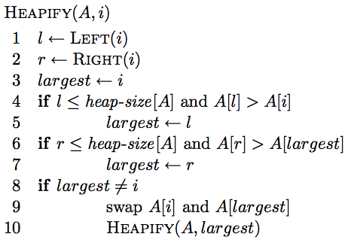
Heapify
Assume left and right children are heaps, turn current node into a valid heap.
aka “sink”

Slide 8
Heapify
Assume left and right children are heaps, turn current set into a valid heap
find out which is largest: current, left of right

Slide 9
Heapify
Assume left and right children are heaps, turn current set into a valid heap
if a child is larger, swap and recurse

Slide 10
Heapify
16 3 10 8 7 9 5 2 4 1
1 2 3 4 5 6 7 8 9 10
16
3
10
8
7
9
5
2
4
1

Slide 11
Heapify
16 3 10 8 7 9 5 2 4 1
1 2 3 4 5 6 7 8 9 10
16
3
10
8
7
9
5
2
4
1

Slide 12
Heapify
16 8 10 3 7 9 5 2 4 1
1 2 3 4 5 6 7 8 9 10
16
8
10
3
7
9
5
2
4
1

Slide 13
Heapify
16 8 10 3 7 9 5 2 4 1
1 2 3 4 5 6 7 8 9 10
16
8
10
3
7
9
5
2
4
1

Slide 14
Heapify
16 8 10 4 7 9 5 2 3 1
1 2 3 4 5 6 7 8 9 10
16
8
10
4
7
9
5
2
3
1

Slide 15
Heapify
16 8 10 4 7 9 5 2 3 1
1 2 3 4 5 6 7 8 9 10
16
8
10
4
7
9
5
2
3
1

Slide 16
Heapify
16 8 10 4 7 9 5 2 3 1
1 2 3 4 5 6 7 8 9 10
16
8
10
4
7
9
5
2
3
1

Slide 17
Correctness of Heapify

Slide 18
Correctness of Heapify
Base case:
Heap with a single element
Trivially a heap

Slide 19

Correctness of Heapify
Both children are valid heaps
Three cases:
Case 1: A[i] (current node) is the largest
parent is greater than both children
both children are heaps
current node is a valid heap

Slide 20
Correctness of Heapify
Case 2: left child is the largest
When Heapify returns:
Left child is a valid heap
Right child is unchanged and therefore a valid heap
Current node is larger than both children since we selected the largest node of current, left and right
current node is a valid heap
Case 3: right child is largest
similar to above

Slide 21
Running time of Heapify
O(height of the tree)
What is the height of the tree?
Complete binary tree, except for the last level
O(log n)

Slide 22
Binary heap - operations
Max - return the largest element in the set
ExtractMax – Return and remove the largest element in the set
Insert(val) – insert val into the set
IncreaseElement(x, val) – increase the value of element x to val
BuildHeap(A) – build a heap from an array of elements

Slide 23
Max
What is the largest element in the set?
Return A[1]
16 14 10 8 7 9 3 2 4 1
1 2 3 4 5 6 7 8 9 10

Slide 24
ExtractMax
Return and remove the largest element in the set
16
14
10
8
7
9
3
2
4
1

Slide 25
ExtractMax
Return and remove the largest element in the set
?
14
10
8
7
9
3
2
4
1

Slide 26
ExtractMax
Return and remove the largest element in the set
14
?
10
8
7
9
3
2
4
1

Slide 27
ExtractMax
Return and remove the largest element in the set
14
8
10
4
7
9
3
?
2
1

Slide 28
ExtractMax
Return and remove the largest element in the set
?
14
10
8
7
9
3
2
4
1

Slide 29
ExtractMax
Return and remove the largest element in the set
1
14
10
8
7
9
3
2
4

Slide 30
ExtractMax
Return and remove the largest element in the set.
Heapify
1
14
10
8
7
9
3
2
4

Slide 31
ExtractMax
Return and remove the largest element in the set
Swap the largest element with the element at the ”last” leaf and delete after swapping.
Heapify
14
8
10
4
7
9
3
2
1

Slide 32
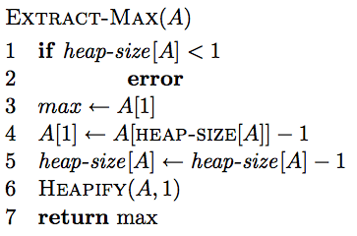
ExtractMax
Return and remove the largest element in the set

Slide 33
ExtractMax running time
Constant amount of work plus one call to Heapify – O(log n)

Slide 34
IncreaseElement (aka swim up)
Increase the value of element x to val.
16
14
10
8
7
9
3
15
2
4
1

Slide 35
IncreaseElement
Increase the value of element x to val
16
14
10
8
7
9
3
2
15
1

Slide 36
IncreaseElement
Increase the value of element x to val
16
14
10
15
7
9
3
2
8
1

Slide 37
IncreaseElement
Increase the value of element x to val
16
14
10
15
7
9
3
2
8
1

Slide 38
IncreaseElement
Increase the value of element x to val
16
15
10
14
7
9
3
2
8
1

Slide 39
IncreaseElement
Increase the value of element x to val
16
Runtime?
15
10
O(height of tree) =
O(log n)
14
7
9
3
2
8
1

Slide 40
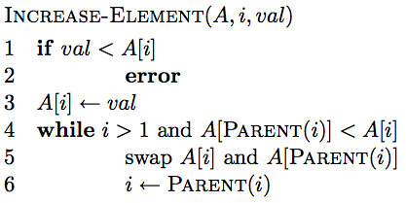
IncreaseElement
Increase the value of element x to val

Slide 41
Correctness of IncreaseElement
Why is it ok to swap values with parent?

Slide 42
Correctness of IncreaseElement
Stop when heap property is satisfied

Slide 43
Running time of IncreaseElement
Follows a path from a node to the root
Worst case O(height of the tree)
O(log n)

Slide 44
Insert
Insert val into the set
16
14
10
6
8
7
9
3
2
4
1

Slide 45
Insert
Insert val into the set
16
14
10
8
7
9
3
2
4
1
6

Slide 46
Insert
Insert val into the set
16
14
10
8
7
9
3
propagate value up
2
4
1
6

Slide 47
Insert
Insert val into the set
16
14
10
8
7
9
3
propagate value up
O(log n)
2
4
1
6

Slide 48
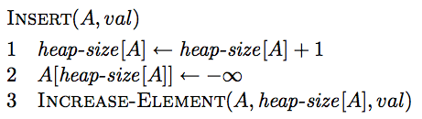
Insert

Slide 49
Running time of Insert
Constant amount of work plus one call to IncreaseElement – O(log n)

Slide 50
Building a heap
Can we build a heap using the functions we have so far?
Max
ExtractMax
Insert(val)
IncreaseElement(x, val)

Slide 51
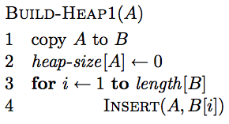
Building a heap
For each element x in array:
insert(x)

Slide 52
Running time of BuildHeap1
n calls to Insert – O(n log n)
Can we do better?
…

Slide 53
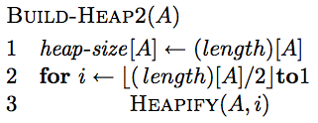
Building a heap: take 2
Start with n/2 “one-node” heaps
Call Heapify on element n/2-1, n/2-2, n/2-3 …
All children have smaller indices
Building from the bottom up, makes sure that all the children are heaps

Slide 54
4 1 3 2 16 9 10 14 8 7
1 2 3 4 5 6 7 8 9 10
4
1
3
2
16
9
10
14
8
7

Slide 55
heapify
4 1 3 2 16 9 10 14 8 7
1 2 3 4 5 6 7 8 9 10
4
1
3
2
16
9
10
14
8
7

Slide 56
heapify
4 1 3 2 16 9 10 14 8 7
1 2 3 4 5 6 7 8 9 10
4
1
3
2
16
9
10
14
8
7

Slide 57
heapify
4 1 3 14 16 9 10 2 8 7
1 2 3 4 5 6 7 8 9 10
4
1
3
14
16
9
10
2
8
7

Slide 58
heapify
4 1 3 14 16 9 10 2 8 7
1 2 3 4 5 6 7 8 9 10
4
1
3
14
16
9
10
2
8
7

Slide 59
heapify
4 1 10 14 16 9 3 2 8 7
1 2 3 4 5 6 7 8 9 10
4
1
10
14
16
9
3
2
8
7

Slide 60
heapify
4 1 10 14 16 9 3 2 8 7
1 2 3 4 5 6 7 8 9 10
4
1
10
14
16
9
3
2
8
7

Slide 61
heapify
4 16 10 14 7 9 3 2 8 1
1 2 3 4 5 6 7 8 9 10
4
16
10
14
7
9
3
2
8
1

Slide 62
heapify
4 16 10 14 7 9 3 2 8 1
1 2 3 4 5 6 7 8 9 10
4
16
10
14
7
9
3
2
8
1

Slide 63
heapify
16 14 10 8 7 9 3 2 4 1
1 2 3 4 5 6 7 8 9 10
16
14
10
8
7
9
3
2
4
1

Slide 64
Correctness of BuildHeap2
Invariant:

Slide 65
Correctness of BuildHeap2
Invariant: elements A[i+1…n] are all heaps
Base case: i = floor(n/2). All elements i+1, i+2, …, n are “simple” heaps
Inductive case: We know i+1, i+2, .., n are all heaps, therefore the call to Heapify(A,i) generates a heap at node i
Termination?

Slide 66
Running time of BuildHeap2
n/2 calls to Heapify – O(n log n)
Can we get a tighter bound?

Slide 67
Running time of BuildHeap2
16
14
10
all nodes at the same level will have the same cost
8
7
9
3
2
4
1
How many nodes are at level d?
2^{d}

Slide 68
Running time of BuildHeap2
?

Slide 69
Nodes at height h
h
< ceil(n/2^{h+1}) nodes
h=2
< ceil(n/8) nodes
h=1
< ceil(n/4) nodes
h=0
< ceil(n/2) nodes

Slide 70
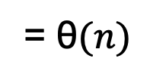
Running time of BuildHeap2
= $\text{θ}(n)$

Slide 71
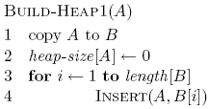

BuildHeap1 vs. BuildHeap2
Runtime
O(n) vs. O(n log n)
Memory
Both O(n)
BuildHeap1 requires an additional array, i.e. 2n memory
Complexity/Ease of implementation

Slide 72
Heap uses
Could we use a heap to sort?

Slide 73
Heap uses
Heapsort
Build a heap
Call ExtractMax for all the elements
O(n log n) running time
Priority queues
scheduling tasks: jobs, processes, network traffic
A* search algorithm

Slide 74
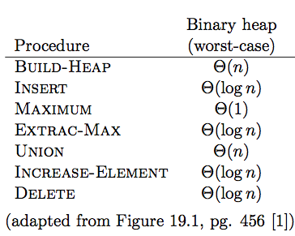
Binary heaps

Slide 75
Mergeable heaps
Mergeable heaps support the union operation
Allows us to combine two heaps to get a single heap
Union runtime for binary heaps?

Slide 76
Union for binary heaps
concatenate the arrays and then call Build-Heap

Slide 77
Linked-list heap
Store the elements in an unordered doubly linked list
Insert:
Max:
Extract-Max:
Increase:
Union:

Slide 78
Linked-list heap
Store the elements in an unordered doubly linked list
Insert: add to the end/beginning
Max: search through the linked list
Extract-Max: search and delete
Increase: increase value
Union: concatenate linked lists

Slide 79
Linked-list heap
Linked-list
Θ(n)
Θ(1)
Θ(n)
Θ(n)
Θ(1)
Θ(1)
Θ(1)
Faster Union, Increase, Insert and Delete… but slower Max operations

Slide 80
Binomial Tree
Adapted from: Kevin Wayne
B₀
B_{k}
B_{k-1}
B_{k-1}
B_{k}: a binomial tree B_{k-1} with the addition of a left child with another binomial tree B_{k-1}
B₀
B₁
B₂
B₃
B₄
Notes:
not binary tree

Slide 81
Binomial Tree
B_{k}
Number of nodes with respect to k?
B₁
B_{k-1}
B₂
B₀
N(B_{o}) = 1
N(B_{k}) = 2 N(B_{k-1}) = 2^{k}
B₀
B₁
B₂
B₃
B₄

Slide 82
Binomial Tree
B_{k}
Height?
B₁
B_{k-1}
B₂
B₀
H(B_{o}) = 1
H(B_{k}) = 1 + H(B_{k-1}) = k
B₀
B₁
B₂
B₃
B₄

Slide 83
Binomial Tree
B_{k}
Degree of root node?
B₁
B_{k-1}
B₂
B₀
k, each time we add another binomial tree
B₀
B₁
B₂
B₃
B₄

Slide 84
Binomial Tree
B_{k}
What are the children of the root?
B₁
B_{k-1}
B₂
B₀
k binomial trees:
B_{k-1}, B_{k-2}, …, B₀
B₀
B₁
B₂
B₃
B₄

Slide 85
Binomial Tree
Why is it called a binomial tree?
depth 0
depth 1
depth 2
depth 3
depth 4
B₄

Slide 86
Binomial Tree
B_{k} has nodes at depth i.
depth 0
depth 1
depth 2
depth 3
depth 4
B₄

Slide 87
Another set data structure: recap
Idea: store data in a collection of arrays
array i has size 2^{i}
an array is either full or empty (never partially full)
each array is stored in sorted order
no relationship between arrays

Slide 88
Another set data structure: recap
Which arrays are full and empty are based on the number of elements
specifically, binary representation of the number of elements
4 items = 100 = A2-full, A1-empty, A₀-empty
11 items = 1011 = A₃-full, A₂-empty, A₁-full, A₀-full
Lookup: binary search through each array
Worst case runtime?
A₀: [5]
A₁: [4, 8]
A₂: empty
A₃: [2, 6, 9, 12, 13, 16, 20, 25]

Slide 89
Binomial Heap
Binomial heap Vuillemin, 1978.
Sequence of binomial trees that satisfy binomial heap property:
each tree is min-heap ordered
top level: full or empty binomial tree of order k
which are empty or full is based on the number of elements
6
3
18
8
29
10
44
37
30
23
22
48
31
17
45
32
24
50
55
B₄
B₁
B₀
Notes:
sequence -> ordered

Slide 90
Binomial Heap
A₀: [18]
A₁: [3, 7]
A₂: empty
A₃: empty
A₄: [6, 8, 29, 10, 44, 30, 23, 22, 48, 31, 17, 45, 32, 24, 55]
6
3
18
8
29
10
44
37
30
23
22
48
31
17
N = 19 # trees = 3 height = 4 binary = 10011
45
32
24
50
55
B₄
B₁
B₀
Notes:
sequence -> ordered

Slide 91
Binomial Heap: Properties
How many heaps?
O(log n) – binary number representation.
6
3
18
8
29
10
44
37
30
23
22
48
31
17
N = 19 # trees = 3 height = 4 binary = 10011
45
32
24
50
55
B₄
B₁
B₀

Slide 92
Binomial Heap: Properties
Where is the max/min?
Must be one of the roots of the heaps.
6
3
18
8
29
10
44
37
30
23
22
48
31
17
N = 19 # trees = 3 height = 4 binary = 10011
45
32
24
50
55
B₄
B₁
B₀

Slide 93
Binomial Heap: Properties
Runtime of max/min?
O(log n)
6
3
18
8
29
10
44
37
30
23
22
48
31
17
N = 19 # trees = 3 height = 4 binary = 10011
45
32
24
50
55
B₄
B₁
B₀

Slide 94
Binomial Heap: Properties
Height?
log₂ n
- largest tree = B_{log n}
- height of that tree is log n
6
3
18
8
29
10
44
37
30
23
22
48
31
17
N = 19 # trees = 3 height = 4 binary = 10011
45
32
24
50
55
B₄
B₁
B₀

Slide 95
Binomial Heap: Union
How can we merge two binomial tree heaps of the same size (2^{k})?
connect roots of H' and H''
choose smaller key to be root of H
Runtime?
O(1)
6
8
29
10
44
30
23
22
48
31
17
45
32
24
50
55
H'
H''

Slide 96
Binomial Heap: Union
6
3
18
8
29
10
44
37
30
23
22
48
31
17
15
7
12
45
32
24
50
28
33
25
55
How can we combine/merge binomial heaps (i.e., a combination of binomial tree heaps)?
Notes:
amusing to consider "multiplying" binomial heaps or other arithmetic ops. Any uses???

Slide 97
Binomial Heap: Union
Go through each tree size starting at 0 and merge as we go
6
3
18
8
29
10
44
37
30
23
22
48
31
17
15
7
12
45
32
24
50
+
55
28
33
25
41
1
1
1
1
0
0
1
1
19 + 7 = 26
+
0
0
1
1
1
1
1
0
1
0
Notes:
amusing to consider "multiplying" binomial heaps or other arithmetic ops. Any uses???

Slide 98
Binomial Heap: Union
6
3
18
8
29
10
44
37
30
23
22
48
31
17
15
7
12
45
32
24
50
+
55
28
33
25
41

Slide 99
Binomial Heap: Union
12
18
6
3
18
8
29
10
44
37
30
23
22
48
31
17
15
7
12
45
32
24
50
+
55
28
33
25
41

Slide 100
3
12
7
37
18
25
6
3
18
8
29
10
44
37
30
23
22
48
31
17
15
7
12
45
32
24
50
+
55
28
33
25
41
12
18

Slide 101
3
3
12
15
7
37
7
37
18
28
33
25
25
41
6
3
18
8
29
10
44
37
30
23
22
48
31
17
15
7
12
45
32
24
50
+
55
28
33
25
41
12
18

Slide 102
3
3
12
15
7
37
7
37
18
28
33
25
25
41
6
3
18
8
29
10
44
37
30
23
22
48
31
17
15
7
12
45
32
24
50
+
55
28
33
25
41
3
12
15
7
37
18
28
33
25
41

Slide 103
3
3
12
15
7
37
7
37
18
28
33
25
25
41
6
3
18
8
29
10
44
37
30
23
22
48
31
17
15
7
12
45
32
24
50
+
55
28
33
25
41
6
3
12
8
29
10
44
15
7
37
18
30
23
22
48
31
17
28
33
25
45
32
24
50
41
55

Slide 104
Binomial Heap: Union
Analogous to binary addition
Running time?
Proportional to number of trees in root lists 2 O(log₂ N)
O(log N)
1
1
1
1
0
0
1
1
19 + 7 = 26
+
0
0
1
1
1
1
1
0
1
0

Slide 105
Binomial Heap: Delete Min/Max
We can find the min/max in O(log n).
How can we extract it?
Hint: B_{k} consists of binomial trees:
B_{k-1}, B_{k-2}, …, B₀
3
6
18
8
29
10
44
37
30
23
22
48
31
17
H
45
32
24
50
55

Slide 106
Binomial Heap: Delete Min
Delete node with minimum key in binomial heap H.
Find root x with min key in root list of H, and delete
H' ← broken binomial trees
H ← Union(H', H)
3
6
18
8
29
10
44
37
30
23
22
48
31
17
H
45
32
24
50
55

Slide 107
Binomial Heap: Delete Min
Delete node with minimum key in binomial heap H.
Find root x with min key in root list of H, and delete
H' ← broken binomial trees
H ← Union(H', H)
Running time?
O(log N)
3
6
18
8
29
10
44
37
30
23
22
48
31
17
H
45
32
24
50
55

Slide 108
Binomial Heap: Decrease Key
Just call Decrease-Key/Increase-Key of Heap
Suppose x is in binomial tree B_{k}
Bubble node x up the tree if x is too small
Running time: O(log N)
Proportional to depth of node x
3
6
18
depth = 3
8
29
10
44
37
30
23
22
48
31
17
H
x
32
24
50
55
Notes:
B_{k} has height k and 2^{k} nodes

Slide 109
Binomial Heap: Delete
Delete node x in binomial heap H
Decrease key of x to -∞
Delete min
Running time: O(log N)

Slide 110
Binomial Heap: Insert
Insert a new node x into binomial heap H
H' ← MakeHeap(x)
H ← Union(H', H)
Running time. O(log N)
3
6
18
x
8
29
10
44
37
30
23
22
48
31
17
H
H'
45
32
24
50
55

Slide 111
Build-Heap
Call insert n times
Runtime?
O(n log n)
Can we get a tighter bound?

Slide 112
Build-Heap
Call insert n times
times
cost
Consider inserting n numbers
how many times will B₀ be empty?
how many times will we need to merge with B₀?
how many times will we need to merge with B₁?
how many times will we need to merge with B₂?
…
how many times will we need to merge with B_{log n}?

Slide 113
Build-Heap
Call insert n times
times
cost
Consider inserting n numbers
how many times will B₀ be empty? n/2 O(1)
how many times will we need to merge with B₀? n/2 O(1)
how many times will we need to merge with B₁? n/4 O(1)
how many times will we need to merge with B₂? n/8 O(1)
…
how many times will we need to merge with B_{log n}? 1 O(1)
Runtime?
Θ(n)

Slide 114
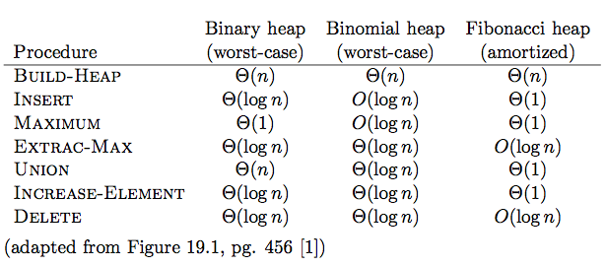
Heaps

Slide 115
Fibonacci Heaps
Similar to binomial heap
A Fibonacci heap consists of a sequence of heaps
More flexible
Heaps do not have to be binomial trees
More complicated ☺

Slide 116
Heaps
Should you always use a Fibonacci heap?

Slide 117
Heaps
Extract-Max and Delete are O(n) worst case
Constants can be large on some of the operations
Complicated to implement

Slide 118
Heaps
Can we do better?

